Slide 1
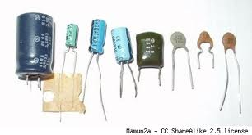
CAPACITORS

Slide 2
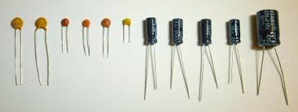

Slide 3
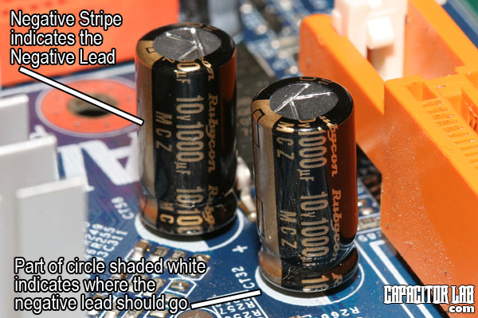
Capacitors

Slide 4
Capacitors
Basic capacitor construction
Dielectric material
The dielectric material is an insulator therefore no current flows through the capacitor
Plate 2
Plate 1

Slide 5
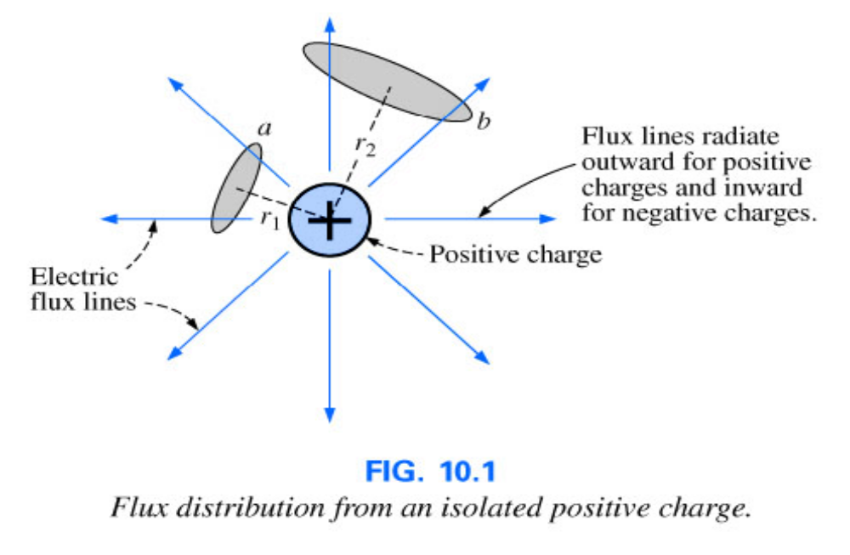
10.2 – The Electric Field
The electric field is represented by electric flux lines, which are drawn to indicate the strength of the electric field at any point around the charged body. The denser the lines of flux, the stronger the electric field.
Notes:
3

Slide 6
The Electric Field
The electric field strength at a point is the force acting on a unit positive charge at that point.
Electric flux lines always extend from a positively charged body to a negatively charged body, always extend or terminate perpendicular to the charged surface, and never intersect.
Notes:
4

Slide 7
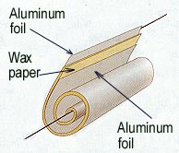
Capacitors
A capacitor is a device for storing electric charge.
It can be any device which can store charges.
Basically, capacitors consists of two metal plates separated by an insulator. The insulator is called dielectric. (e.g. polystyrene, oil or air)
Circuit symbol:
+
Dielectric
_

Slide 8
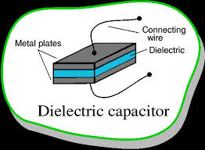
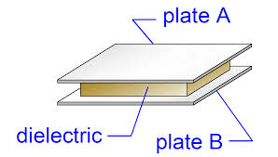
Dielectrics

Slide 9
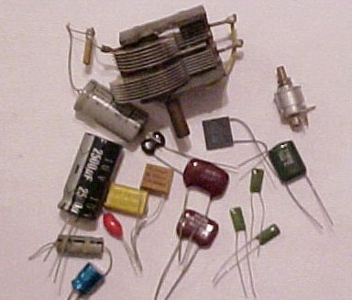
Examples of Capacitors
Paper, plastic, ceramic and mica capacitors
Electrolytic capacitors
Air capacitors

Slide 10
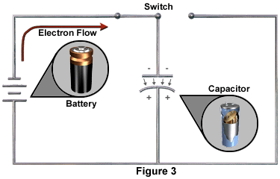
Charging a capacitor
Q
R
R
t
Computer simulation 1

Slide 11
Discharging a capacitor
I
I decreases exponentially with t.
R
R
t

Slide 12
Charging of capacitors
When a capacitor is connected across a battery, electrons flow from the negative terminal of the battery to a plate of the capacitor connected to it. At the same rate, electrons flow from the other plate of the capacitor to the positive terminal of the battery. This gives a flow of current as the capacitor is being charged.
As charges accumulate on the plates of the capacitor, electric potential built across the plates. This hinders further accumulation of charges and makes the charge up current decreasing. When the potential difference across the plates equals that of the battery, the current becomes zero.

Slide 13
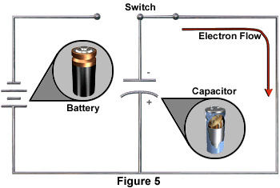
Discharging of Capacitors (1)
Q
R
R
t
Computer simulation 1

Slide 14
Discharging of Capacitors (1)
I
R
R
t

Slide 15
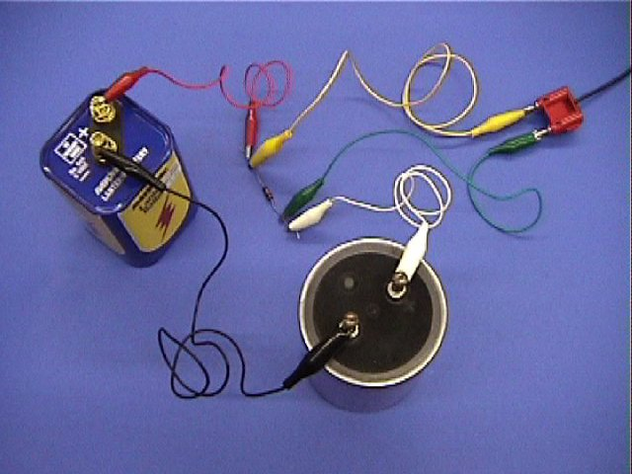

Slide 16
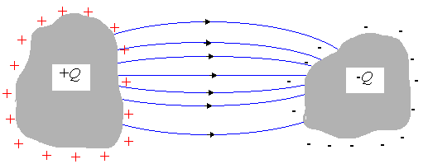
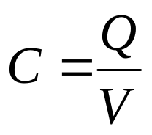
Capacitance (1)
Consider any isolated pair of conductors with charge Q
Capacitance is defined as
Unit : farad (F)
where Q = charge on one conductor
V = potential difference between two conductors

Slide 17
  A capacitor has a capacitance of 1 farad (F) if 1 coulomb (C) of charge is deposited on the plates by a potential difference of 1 volt across its plates.
  The farad is named after Michael Faraday, a nineteenth century English chemist and physicist.

Slide 18

Capacitance of a Capacitor
Capacitance is a measure of a capacitor's ability to store charge.
The more charge a capacitor can hold at a given potential difference, the larger is the capacitance.
Capacitance is also a measure of the energy storage capability of a capacitor.
Unit of capacitance: CV⁻¹ or farad (F).
Farad is a very large unit. Common units are 1μF = 10⁻⁶ F, 1nF = 10⁻⁹ F and 1pF = 10⁻¹² F

Slide 19
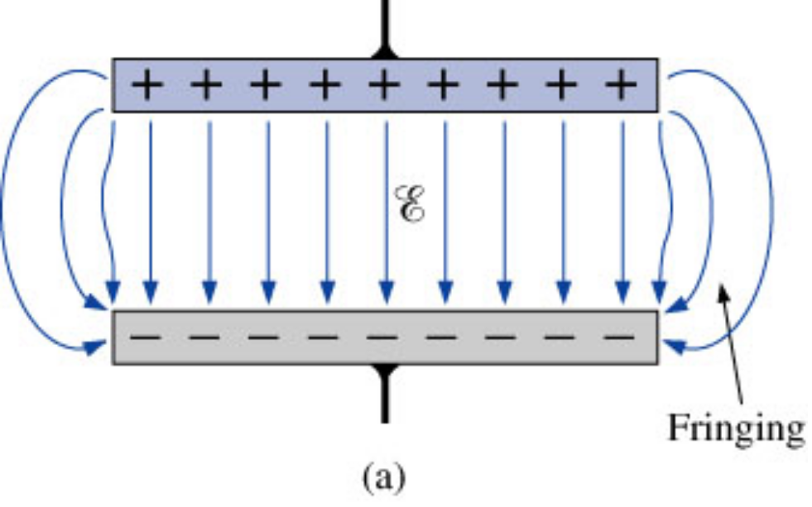
Capacitance
Fringing – At the edge of the capacitor plates the flux lines extend outside the common surface area of the plates.
Notes:
7

Slide 20
Capacitance
Dielectric – Insulator of the capacitor
  The purpose of the dielectric is to create an electric field to oppose the electric field setup by free charges on the parallel plates.
  Di for “opposing” and electric for “electric field”
Notes:
8

Slide 21
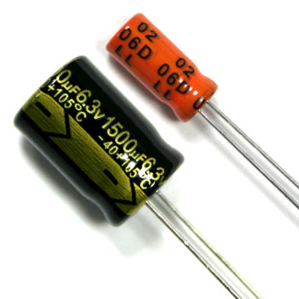
Markings of capacitor
Consider a ‘6.3V 1500μF’ capacitor shown in the following figure. Note that:
(1) Maximum voltage across the capacitor should not exceed 6.3 V, otherwise (leakage or) breakdown may occur.
(2) Capacitance of 1500μF means the capacitor holds 1500μC of charge.

Slide 22
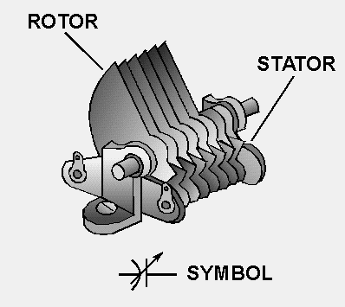
Application – variable capacitors
A variable capacitor is a capacitor whose capacitance may be intentionally and repeatedly changed mechanically or electronically
Variable capacitors are often used in circuits to tune a radio (therefore they are sometimes called tuning capacitors).
simulation

Slide 23
Permittivity of dielectric between the plates
Dielectric | Relative permittivity
Vacuum | 1
Air | 1.0006
Polythene | 2.3
Waxed paper | 2.7
Mica | 5.4
Glycerin | 43
Pure water | 80
Strontium titanate | 310
A dielectric is an insulator under the influence of an E field. The following table shows some dielectrics and their corresponding relative permittivity.
Capacitance can be increased by replacing the dielectric with one of higher permittivity.

Slide 24
Action of Dielectric (1)
A molecule can be regarded as a collection of atomic nuclei, positively charged, and surrounded by a cloud of negative electrons.
- -
-
- -
- -
-
- -
+
net -ve
charge
+
net +ve
charge
no field
no net charge
Field
When the molecule is in an electric field, the nuclei are
urged in the direction of the field, and the electrons in
the opposite direction.
The molecule is said to be polarized.

Slide 25
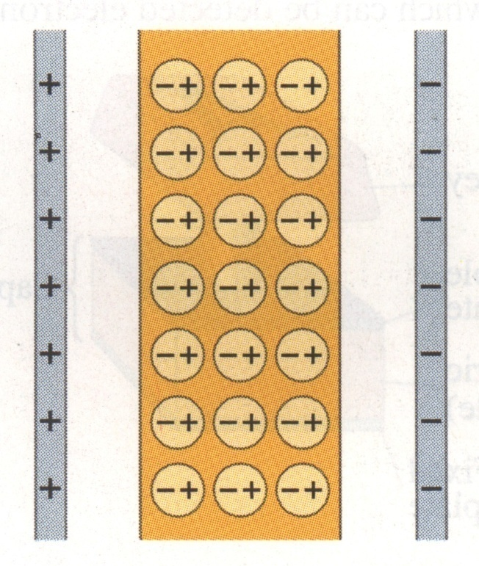
Action of Dielectric (2)
When a dielectric is in a charged capacitor, charges appear as shown below.
These charges are of opposite sign to the charges on the plates.
The charges reduce the electric
field strength E between the plates.
The potential difference between
the plates is also reduced as E = V/d.

Slide 26
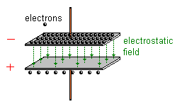
Charged Capacitor
A capacitor is said to be charged when there are more electrons on one conductor plate than on the other.
When a capacitor is charged, energy is stored in the dielectric material in the form of an electrostatic field.

Slide 27
Functions of Dielectrics
It solves the mechanical problem of maintaining two large metal plates at a very small separation without actual contact.
Using a dielectric increases the maximum possible potential difference between the capacitor plates.
With the dielectric present, the p.d. for a given charge Q is reduced by a factor ε_{r} and hence the capacitance of the capacitor is increased.

Slide 28
Relative permittivity of some dielectrics
Dielectric | Relative permittivity
Vacuum | 1
Air | 1.0006
Polythene | 2.3
Waxed paper | 2.7
Mica | 5.4
Glycerin | 43
Pure water | 80
Strontium titanate | 310

Slide 29
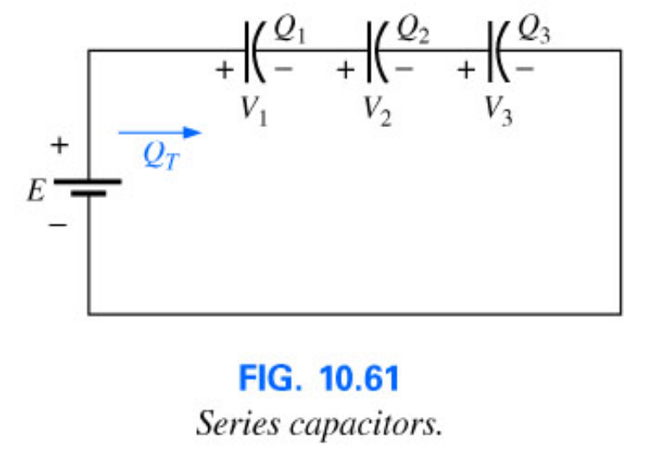
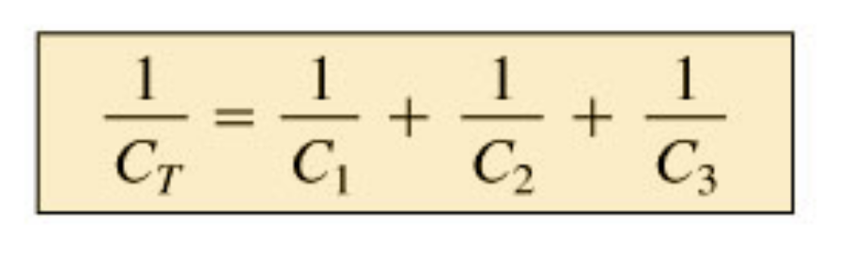
10.11 – Capacitors in Series and Parallel
Capacitors, like resistors, can be placed in series and in parallel.
When placed in series, the charge is the same on each capacitor.
Notes:
26

Slide 30
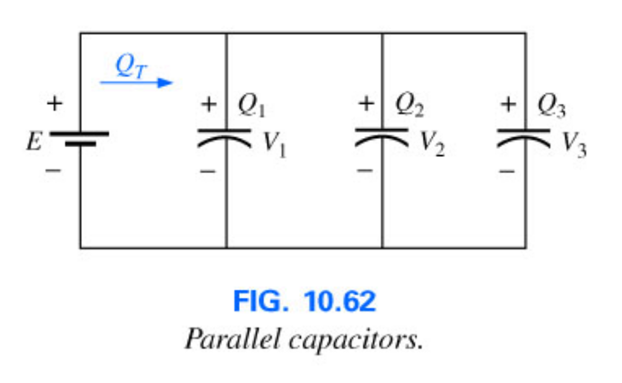
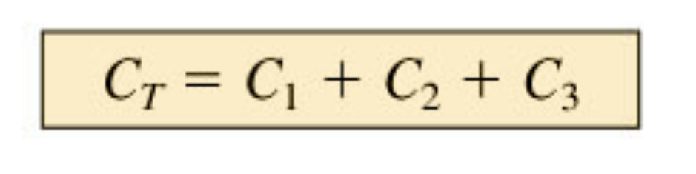
Capacitors in Series and Parallel
Placing capacitors in parallel the voltage across each capacitor is the same.
The total charge is the sum of that on each capacitor.
Notes:
27

Slide 31
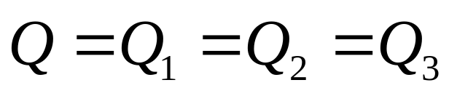
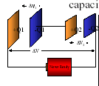
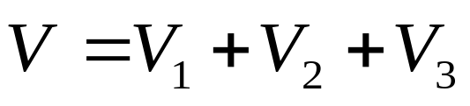
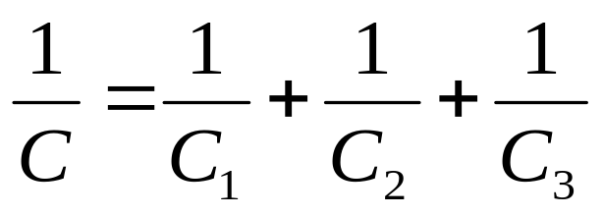
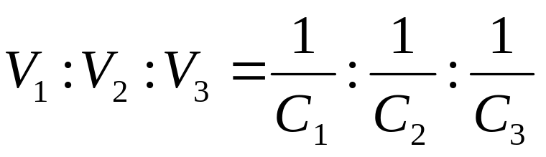
Combination of Capacitor (1)
In series
The resultant capacitance is smaller than the smallest
Individual one.

Slide 32

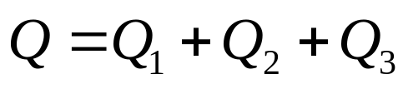
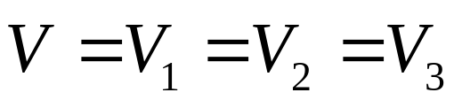
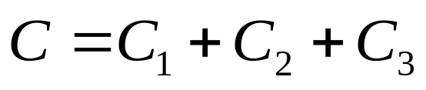
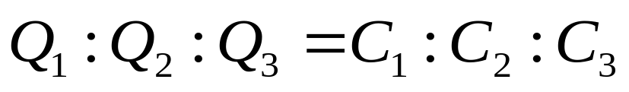
Combination of Capacitors (2)
In parallel
The resultant capacitance is greater
Than the greatest individual one.

Slide 33
10.4 – Capacitors
Types of Capacitors
  Fixed – mica, ceramic, electrolytic, tantalum and polyester-film
  Mica capacitor consists of mica sheets separated by sheets of metal foil. The plates are connected to two electrodes. The entire system is encased in a plastic insulating material.
  The mica capacitor exhibits excellent characteristics under stress of temperature variations and high voltage applications.
Notes:
12

Slide 34
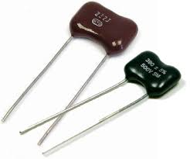
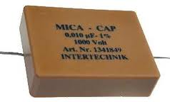
Mica Capacitors

Slide 35
Capacitors
Electrolytic Capacitors
Most commonly used in situations where capacitances of the order of one to several thousand microfarads are required.
  Primarily for use in dc networks because they have good insulating characteristics (high leakage current) between the plates in one direction but take on the characteristics of a conductor in the other direction.
  Basic construction consists of a roll of aluminum foil coated on one side with an aluminum oxide, the aluminum being the positive plate and the oxide the dielectric. A layer of paper or gauze saturated with an electrolyte is placed over the aluminum oxide on the positive plate. Another layer of aluminum without the oxide is then placed over this layer to assume the role of the negative plate.
Notes:
14

Slide 36
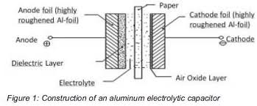
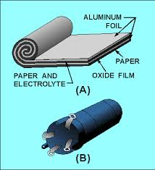
Electrolytic Capacitors

Slide 37
Capacitors
Polyester-film Capacitors
  Basic construction consists of two metal foils separated by a strip of polyester material such as Mylar. The outside layer of polyester is applied to act as an insulating jacket.
  Each metal jacket is connected to a lead that extends either axially or radially from the capacitor.
  The rolled construction results in a large surface, and the use of the plastic dielectric results in a very thin layer between the conducting surfaces.
  The capacitor can be used for both dc and ac networks.
Notes:
17

Slide 38
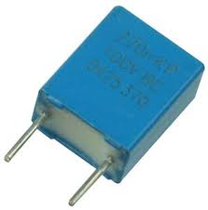



Polyester Capacitors

Slide 39
Capacitors
Ceramic Capacitors
Made in different shapes and sizes but the basic construction is the same
  A ceramic base is coated on both sides with a metal, such as copper or silver, to act as the two plates. The leads are then attached through electrodes to the plates. An insulating coating of ceramic or plastic is then applied over the plates and dielectric.
  Ceramic capacitors have very low leakage current and can be used in both dc and ac networks.
Notes:
13

Slide 40
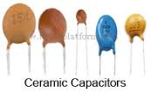
Ceramic Capacitors

Slide 41
Capacitors
Working voltage – the voltage that can be applied across a capacitor for long periods of time with out breakdown
Surge voltage – The maximum dc voltage that can be applied for a short period of time
Leakage current – The current that results in the total discharge of a capacitor as the capacitor is disconnected from the charging network for a sufficient length of time.
Notes:
15

Slide 42
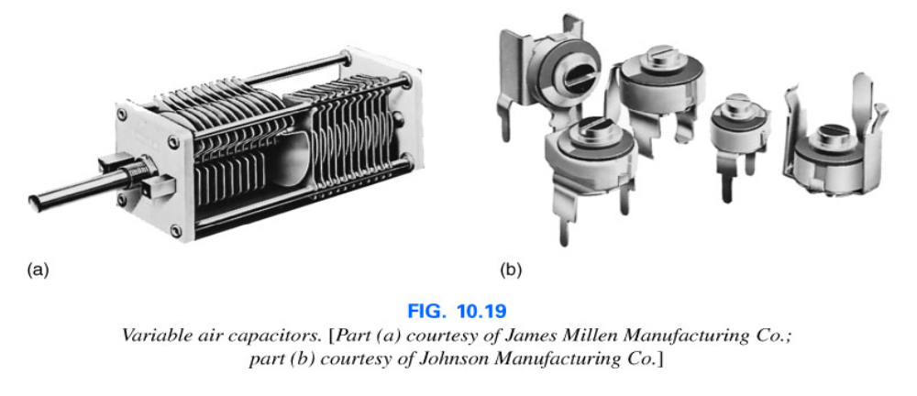
Capacitors
Variable Capacitors
  Most common are shown in the figure below. The dielectric for each is air. The capacitance is changed by turning the shaft at one end to vary the common area of the movable and fixed plates. The greater the common area the larger the capacitance.
Notes:
18

Slide 43
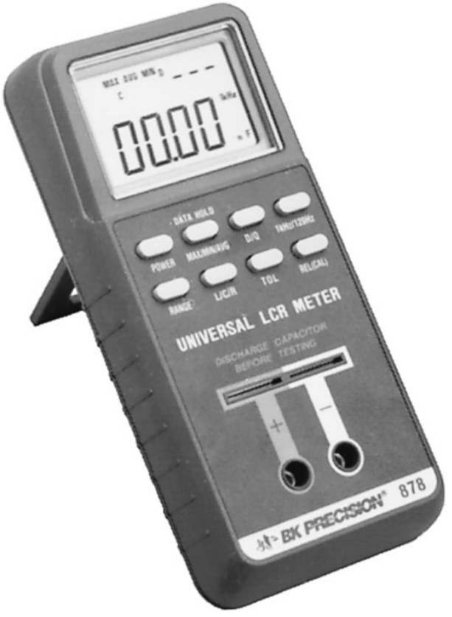
Capacitors
Measuring and testing
  The digital reading capacitance meter shown will allow you to simply place the capacitor between the provided clips with the proper polarity and the meter will display the level of capacitance.
Insert Fig 10.20
Notes:
19

Slide 44
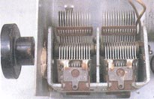
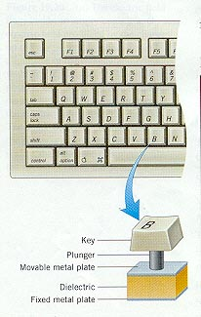
Applications of Capacitors (1)
The capacitance is varied by
altering the overlap between
a fixed set of metal plates
and a moving set. These are
used to tune radio receiver.
Press the key on a computer keyboard reduce the capacitor spacing thus increasing the capacitance which can be detected electronically.

Slide 45
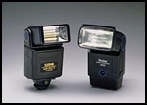
Applications of Capacitors (3)
Electronic flash on a camera
  The battery charges up the flash’s capacitor over several seconds, and then the capacitor dumps the full charge into the flash tube almost instantly.
  A high voltage pulse is generated across the flash tube.
  The capacitor discharges through gas in the the flash tube and bright light is emitted.

Slide 46
Applications
Capacitors find applications in:
  Electronic flash lamps for cameras
  Timing circuits
  Electronic power supplies
Energy storage
Filter Applications
Notes:
30

Slide 47
THANKS

